Slide 1
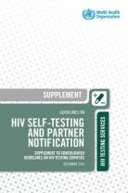
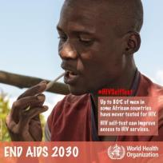
It take a community to reach those left behind! Community-based HIV testing 101
Dr Van Nguyen
World Health Organization
AIDS 2018
26 July 2018

Slide 2
Progress toward the 90-90-90, 2015-2017
9.4 million people living with HIV (PLHIV) remain undiagnosed
59%
41%
Source: UNAIDS 2018

Slide 4
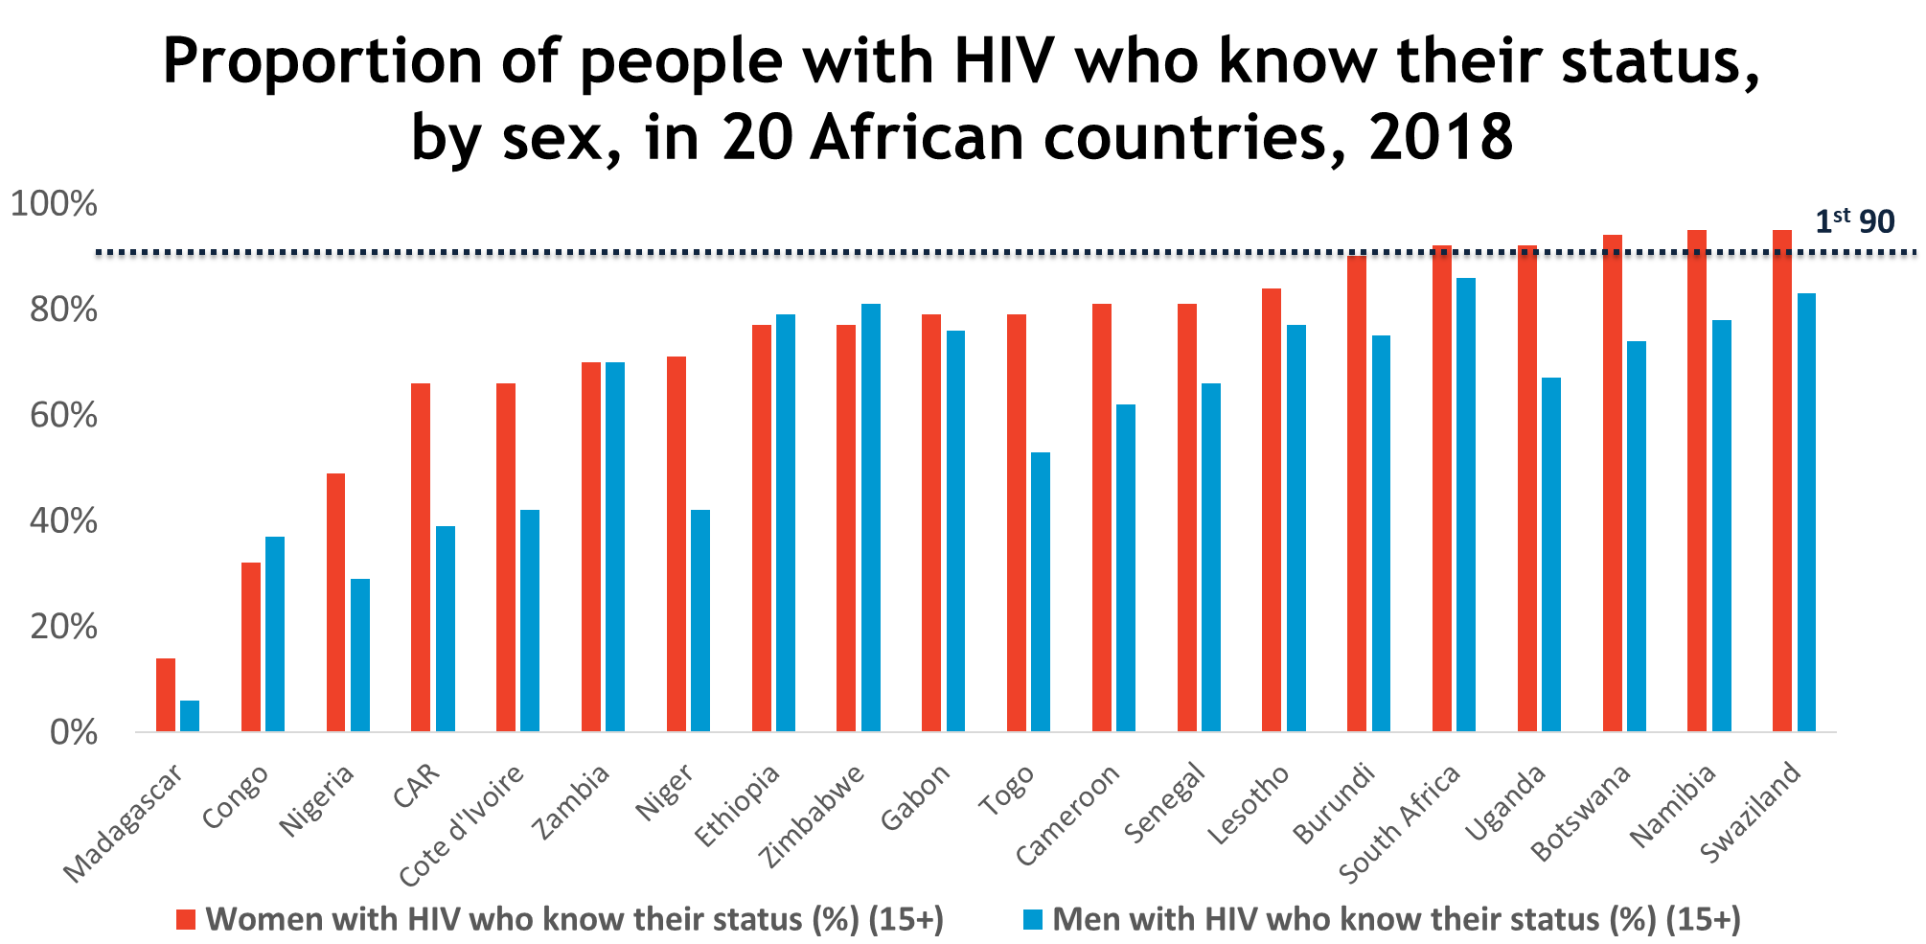
Men less likely to know their HIV positive status…
Source: UNAIDS 2018

Slide 5
How do we address these gaps?

Slide 6
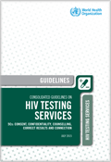
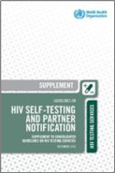
Recommended HIV Testing Services Important gateway to treatment and prevention for individuals, couples, partners and families
Facility-based: Offering HIV testing in a facility, e.g. VCT, in-patient and out-patient clinics, ANC, TB, STI.
Community-based: Offering HIV testing in natural setting of the community, e.g. outreach, CBOs, workplace, clubs, bars.
Assisted partner notification: Assisting individuals with HIV by contacting their sexual and/or drug injecting partners and offering them HIV testing services.
HIV self-testing: Offering self-test kit for individual, and/or their partner, enabling them to collect their sample (oral or blood), perform test, and interpret results in private. All reactive results need confirmation.
HIV Testing Services
ART
Retesting
SRH
Testing Partners & Families
HIV Prevention
Partner notification
Other support services
Other clinical services
Source: WHO 2015; WHO 2016
Notes:
HIV testing is an important gateway to treatment and prevention.
Following an HIV test:
Those who test negative can be linked to effective HIV methods, e.g. voluntary male medical circumcision, pre exposure prophylaxis, harm reduction and condoms
Those who test positive can be linked to lifesaving treatment
There are many different approaches: In facility settings, community-settings or through self-testing

Slide 7
Recommended HIV Testing Services Important gateway to treatment and prevention for individuals, couples, partners and families
Facility-based: Offering HIV testing in a facility, e.g. VCT, in-patient and out-patient clinics, ANC, TB, STI.
Community-based: Offering HIV testing in natural setting of the community, e.g. outreach, CBOs, workplace, clubs, bars.
Assisted partner notification: Assisting individuals with HIV by contacting their sexual and/or drug injecting partners and offering them HIV testing services.
HIV self-testing: Offering self-test kit for individual, and/or their partner, enabling them to collect their sample (oral or blood), perform test, and interpret results in private. All reactive results need confirmation.
HIV Testing Services
ART
Retesting
SRH
Testing Partners & Families
HIV Prevention
Partner notification
Other support services
Other clinical services
Source: WHO 2015; WHO 2016
Notes:
HIV testing is an important gateway to treatment and prevention.
Following an HIV test:
Those who test negative can be linked to effective HIV methods, e.g. voluntary male medical circumcision, pre exposure prophylaxis, harm reduction and condoms
Those who test positive can be linked to lifesaving treatment
There are many different approaches: In facility settings, community-settings or through self-testing

Slide 8
Community is key!

Slide 9
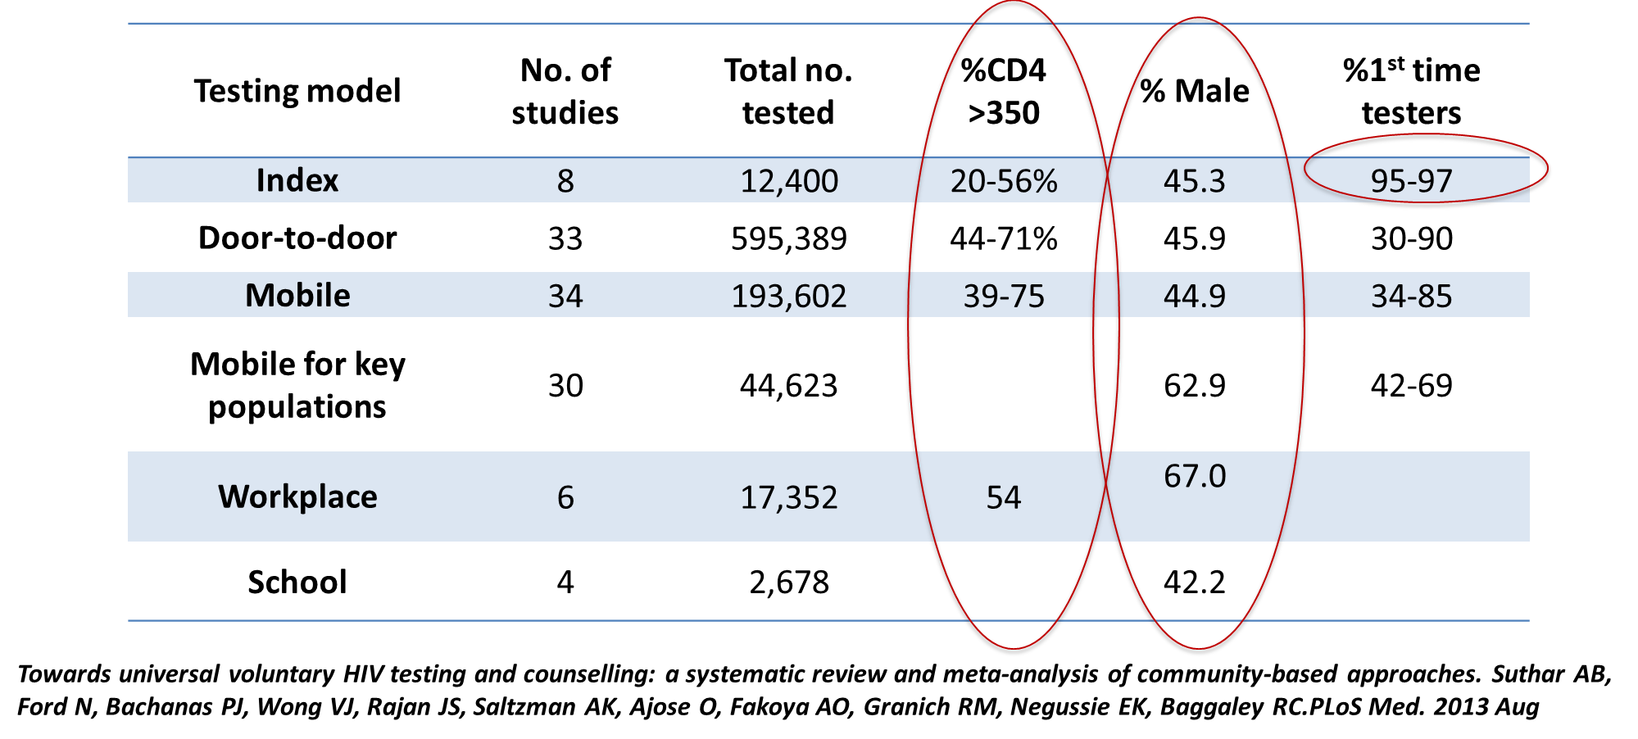
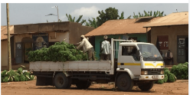
Community-based HIV testing approaches Identifying people earlier and first-time testers
In Uganda offering “moonlight” testing at trading posts –Integrated testing – offering BP checks, vision screening, information on prostate cancer reached 53% men* (Oral abstract THAC0402, Thursday at 4.30pm)
Source: Ruanne Barnabas

Slide 10
Presentation on Testing for Workers
Thursday 14:00-14:30 in Global Village 506/507
In South Africa, under STAR Initative, 110,114 test kits have been distributed through workplaces
65% distributed directly to males
47% reported not having tested previously or having tested more than 12 months previously
Source: Afsar; ILO 2018; Majam 2018

Slide 11
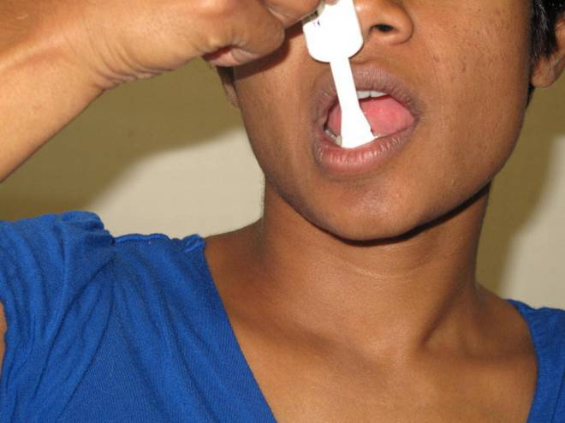
What is HIV self-testing?
When a person collects his or her own specimen, performs a rapid HIV test and interprets their result
All reactive self-tests need further testing
Source: WHO 2016

Slide 12
Test for Triage
A single rapid diagnostic test in community-based HIV testing
Not a definitive test for those who test +ve
Emphasis on HIV diagnosis at health facility (start at A1)
Triage – prioritize linkage following testing as appropriate
Perform test for triage
A0
A0 +
A0 –
Report HIV-
Recommend repeat testing as needed
Link to HIV testing for diagnosis, care & treatment

Slide 13
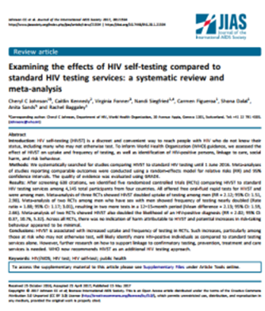
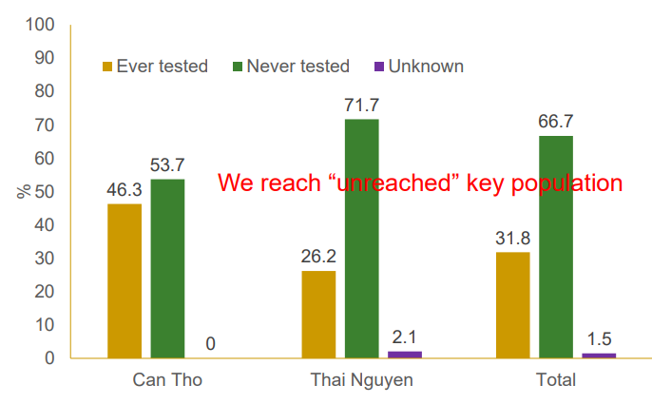
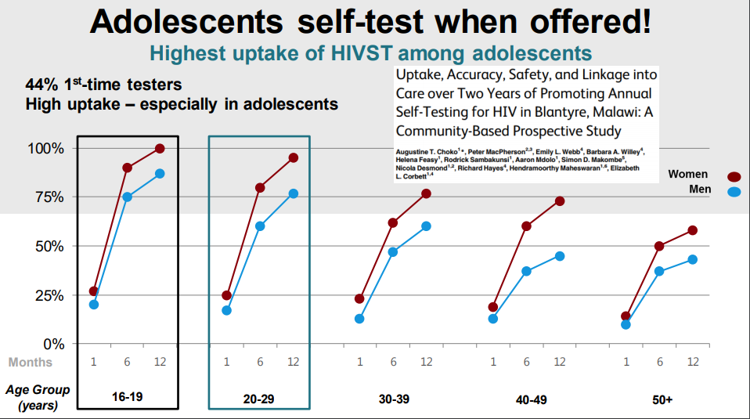
HIV self-testing
Significantly increased men’s:
Uptake of HIV testing;
Partner testing; and
Frequency of testing among high-risk MSM
Source: Johnson 2017; Nguyen 2018;Choko 2015

Slide 14
Where to Begin with HIV Self-Testing
Know your epidemic
& testing gap
Approaches
Considerations
Couples & Partners
Community-based
(outreach, door-to-door)
Facility-based
(PITC, drop-in centres)
Benefits & Risks to Populations
Support tools
Linkage
Increased access
Increased coverage
Men
VMMC programmes
Workplace programmes
Key populations
Pharmacies & Kiosks
Integrated in KP Programmes
Young people
Internet & Apps
Integrated in RHS & Contraceptive Services
Other
At risk populations
(SDC, partners of PLHIV, migrants etc.)
Vending machines
Partner-delivered
Notes:
Whose at risk, in need of testing & not reached by existing services

Slide 15
Where to Begin with HIV Self-Testing
Know your epidemic
& testing gap
Approaches
Considerations
Couples & Partners
Community-based
(outreach, door-to-door)
Facility-based
(PITC, drop-in centres)
Benefits & Risks to Populations
Support tools
Linkage
Increased access
Increased coverage
Men
VMMC programmes
Workplace programmes
Key populations
Pharmacies & Kiosks
Integrated in KP Programmes
Young people
Internet & Apps
Integrated in RHS & Contraceptive Services
Other
At risk populations
(SDC, partners of PLHIV, migrants etc.)
Vending machines
Partner-delivered
Notes:
Whose at risk, in need of testing & not reached by existing services

Slide 16
Where to Begin with HIV Self-Testing
Know your epidemic
& testing gap
Approaches
Considerations
Couples & Partners
Community-based
(outreach, door-to-door)
Facility-based
(PITC, drop-in centres)
Benefits & Risks to Populations
Support tools
Linkage
Increased access
Increased coverage
Men
VMMC programmes
Workplace programmes
Key populations
Pharmacies & Kiosks
Integrated in KP Programmes
Young people
Internet & Apps
Integrated in RHS & Contraceptive Services
Other
At risk populations
(SDC, partners of PLHIV, migrants etc.)
Vending machines
Partner-delivered
Notes:
Whose at risk, in need of testing & not reached by existing services

Slide 17
Where to Begin with HIV Self-Testing
Know your epidemic
& testing gap
Approaches
Considerations
Couples & Partners
Community-based
(outreach, door-to-door)
Facility-based
(PITC, drop-in centres)
Benefits & Risks to Populations
Support tools
Linkage
Increased access
Increased coverage
Men
VMMC programmes
Workplace programmes
Key populations
Pharmacies & Kiosks
Integrated in KP Programmes
Young people
Internet & Apps
Integrated in RHS & Contraceptive Services
Other
At risk populations
(SDC, partners of PLHIV, migrants etc.)
Vending machines
Partner-delivered
Notes:
Whose at risk, in need of testing & not reached by existing services

Slide 18
Within community-based testing – partner notification is also important to carry out
Partner notification or contact tracing, is a voluntary process whereby a trained provider asks people diagnosed with HIV about their sexual partners and/or drug injecting partners and then, if the HIV-positive client agrees, offers these partners HTS.
Passive referral (HIV+ client contacts their partners themselves)
Assisted approaches (health provider assists with contacting partners)
Provider-referral – provider contacts partners directly
Contract referral – client enters into “contract” with provider to refer partners within a specific period. If the partner doesn’t access HTS in that time, provider contacts partner
Dual referral – Provider accompanies HIV+ clients when they disclose their status to partners and offer HTS

Slide 19
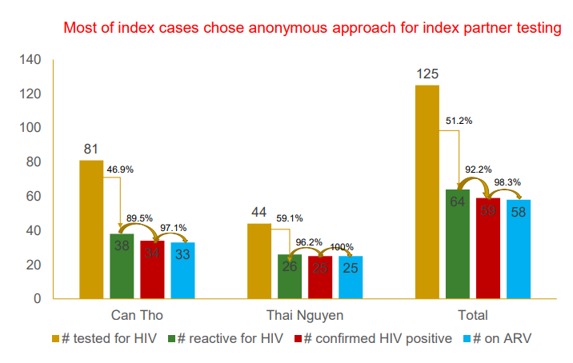
Index partner testing in Viet Nam for key populations

Slide 20
Differentiated HIV testing services

Slide 21
Lay provider HIV testing
Lay provider: any person who performs functions related to health-care delivery and has been trained to deliver specific services but has received no formal professional or paraprofessional certificate or tertiary education degree.
Trained lay providers can safely and effectively perform HIV testing services using rapid diagnostic tests.
(strong recommendation, moderate quality evidence)
Important considerations
Choose wisely –select and train lay providers well-matched to clientele
Ongoing training, mentoring and support is key—having a QMS in place is essential
Adequate remuneration – trained lay providers should receive adequate compensation
National policies need to establish a role for trained lay providers to perform HTS
Lay providers are critical to community service delivery and closing testing gap!

Slide 22
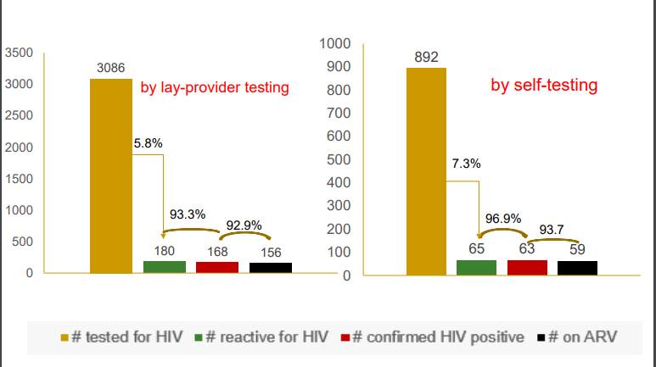
Both community-delivered HIV self-testing and lay provider testing are effective!

